Slide 1

Good Afternoon!

Slide 2

Socio-economic Drivers
of Political Polarization
Team members:
Keyur Chaudhari
Anish Gaware
Yash Annapure
Mirang Bhandari
PRESENTED TO
PRESENTED BY
Ralf Storch
Frank Schulz
DataSmiths

Slide 3

Why did we choose this question?
To understand which socio-economic and demographic factors drive party vote share across Germany’s 16 states and which regions and voter groups are most influential in shaping electoral outcomes.

Slide 4

Steps:
Access
Investigate
Cleanse
Analysis
Report

Slide 5
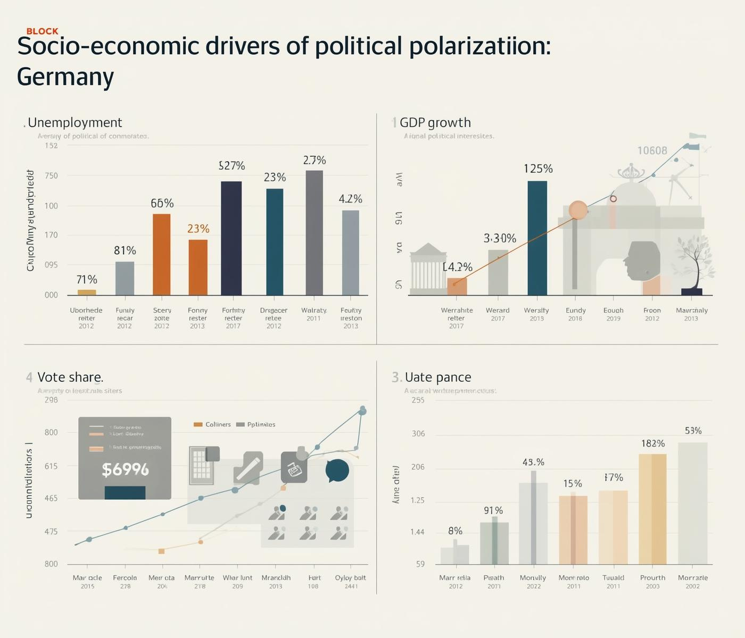
Where did we get the data from?
Access

Slide 6

Socio-economic Drivers
of Political Polarization
Investigate
ADSA

Slide 7

How we cleaned the raw data and created master table?
Cleaning

Slide 8

Analysis
We used SAS Viya for analysing and visualising the database to find the correlations between the socio-economic factors.

Slide 9

Report creation and Recommendations

Slide 10

Danke Schön!
Questions?

